Slide 1
BayCAN Spring All-Region Meeting May 5, 2021 9:00 am – Noon

Slide 2
Agenda
Welcome and Agenda Review
BayCAN New and Expanded Program for 2021-22
Keynote: Just Resilience and Recovery – Amee Raval, APEN
--Presentation and Breakouts
Legislation and Money from Sacramento and D.C.
Bay Area Adaptation and Resilience News
The 2021 Heat, Drought and Fire Season – Daniel Swain, UCLA
-- Presentation and Breakouts
A Climate Science Services Program for the Bay Area

Slide 3
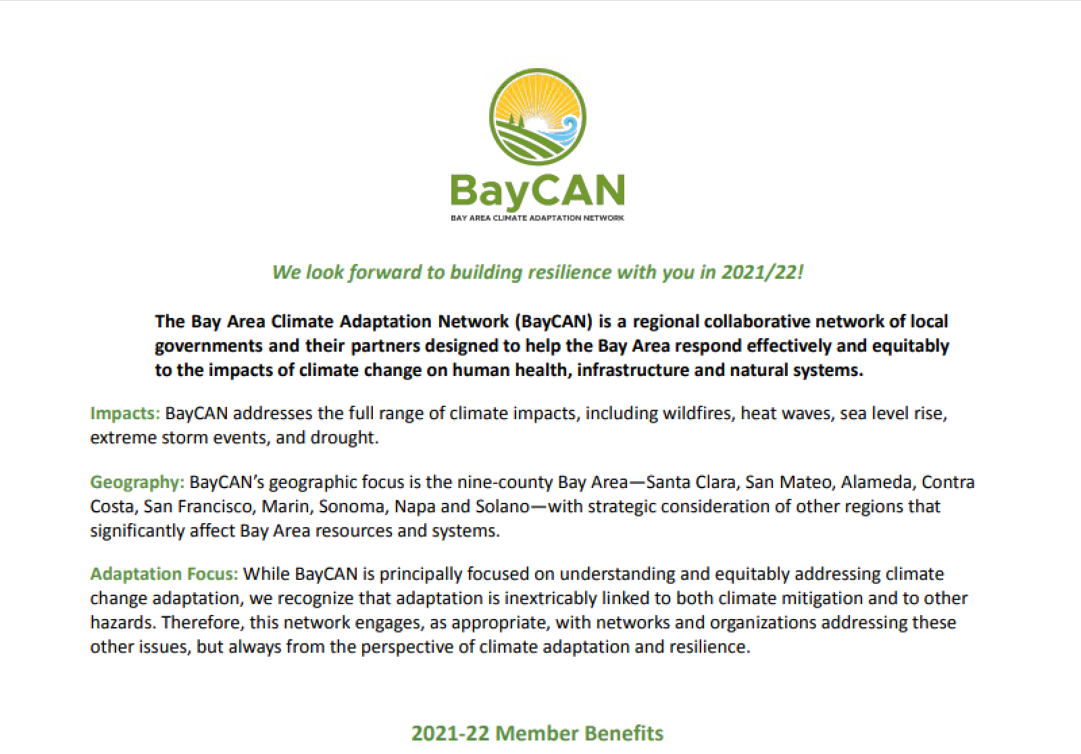
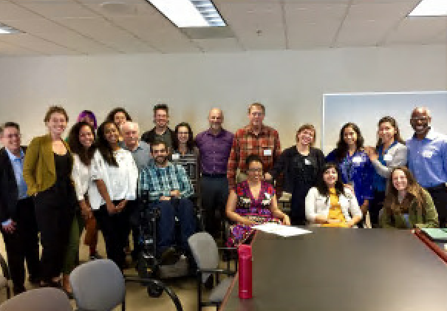
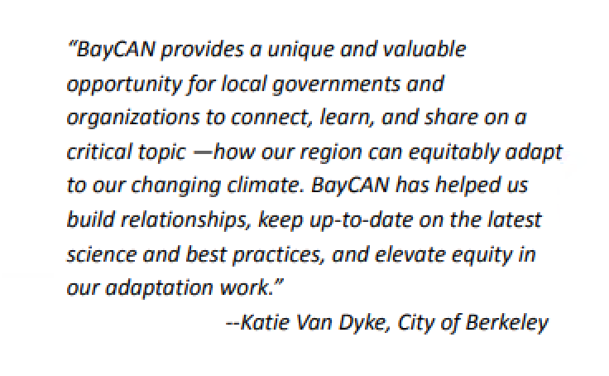
Membership Renewal Time!

Slide 4
BayCAN Membership Invoices Sent April 21 to Key Contacts
What you will see in your in-box: from “Local Government Commission”

Slide 5
FY21-22 Program Plan
 | BayCAN 2021-2022 Program Plan
 | Objectives:
 | 1. Respond to the growing urgency and activity in equitable climate adaptation and regional collaboration |  |  |  | 2. Respond to member demand for information, networking, and development and sharing of best practices |  |  |  | 3.Build on BayCAN's success to date by enhancing and expanding upon existing work where feasible
 | Activities:
 | Member Services |  |  |  | Programs |  |  |  | Learning Networks
 | Regional Meetings |  |  |  | Equity |  |  |  | Peer-to-Peer Networks
 | Hold quarterly half-day ZOOM meetings including networking, expert speakers and info sharing |  |  |  | Advance Bay Area work to center equity in adaptation planning through consultations, resources, training, and networking services. |  |  |  | Establish two peer-to-peer networks — Counties and Water Districts — for networking, info sharing and problem solving
 | Consultations |  |  |  | Climate Science Services |  |  |  | Emerging Hot Topics
 | Conduct quarterly phone or Zoom calls with each member to ID needs, provide resources and make referrals |  |  |  | Provide assistance to members seeking actionable science for planning. Form a Bay Area Science Advisory Panel. |  |  |  | Facilitate ad hoc groups of BayCAN members to help them prepare for the Heat and Fire seasons for 2021 and 2022
 | Resource Hub |  |  |  | State Government Engagement |  |  |  | Other Learning Networks TBD
 | Manage the BayCAN communictions hub — www.BayCANadapt.org, BayCAN Newsletter, Project Map |  |  |  | In conjunction with statewide ARCCA, advocate for increased adaptation funding and supportive programs |  |  |  | Create additional learning networks based on member demand and budget

Slide 6
2021 Key Legislation & Budget Update
California:
AB 897 – Regional climate adaptation planning
SB 1 – California Sea Level Rise State and Regional Support Collaborative
AB 585 – Extreme Heat and Community Resilience Program
AB 1087 - Environmental Justice Community Resilience Hubs Program
AB 1500 – $6.9 billion bond (2022 ballot– water, flood, fire, heat, drought, workforce
SB 45 – $5.5 billion bond (2022 ballot) wildfire, flood, drought, water
https://arccacalifornia.org/2021-legislative-tracker
New CA budget out by May 15th (budget surplus)
Biden budget proposal +$14 billion for climate
Clean electricity, Transportation, Environmental Justice, Climate Impacts, Climate Science
All-Star climate team

Slide 7
What are “climate services”?
A Climate Service is the provision of climate information to assist decision-making.
The service must respond to user needs, must be based on scientifically credible information and expertise, and requires appropriate engagement between the users and providers.
From “Climateurope: Linking Science and Society”, at https://www.climateurope.eu/

Slide 8
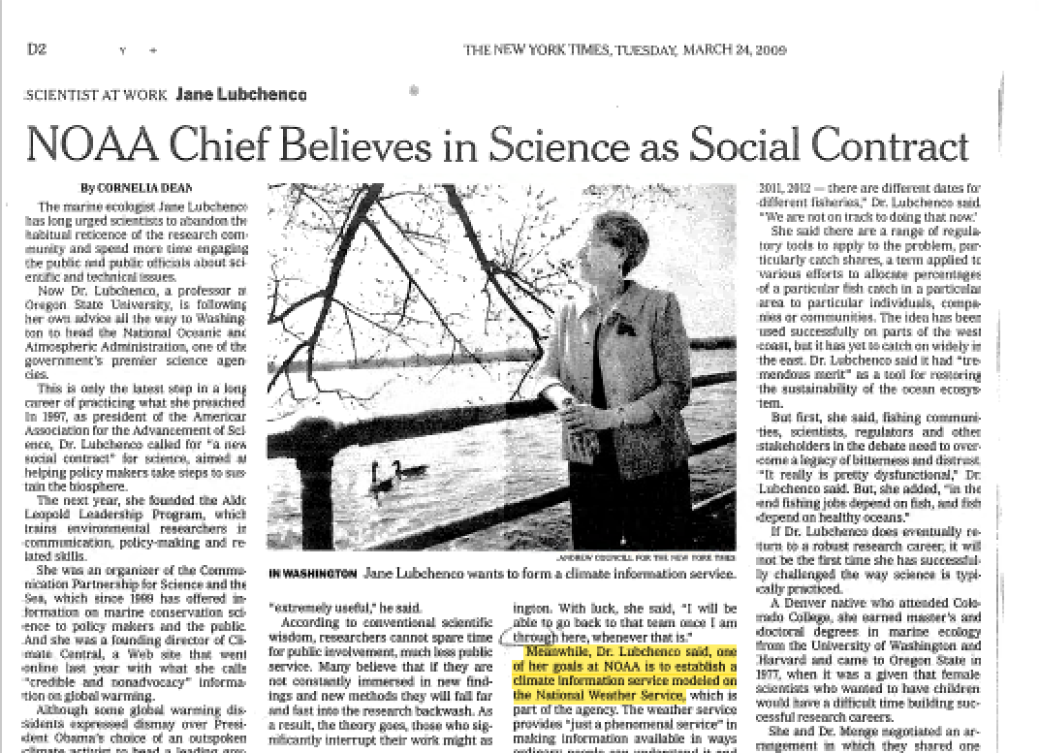
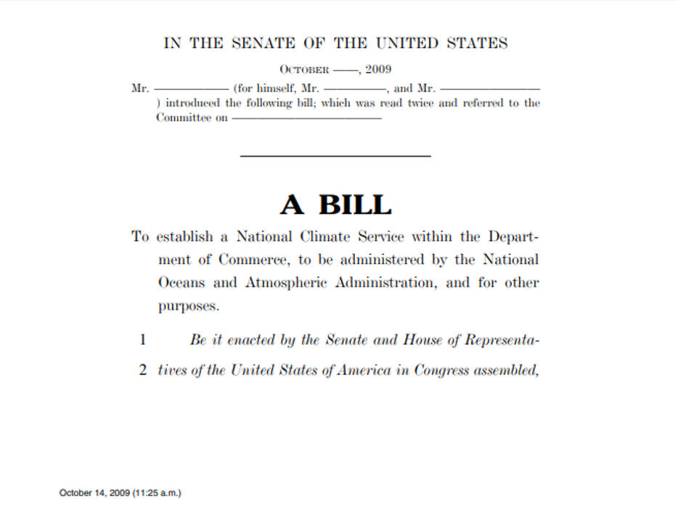
National Climate Service - 2009

Slide 9
National Climate Service - 2021
Escalating climate risks will outpace climate services without federal action
BY RICHARD MOSS AND KATHY JACOBS, OPINION CONTRIBUTORS — 04/27/21 07:00 PM EDT
“With so many different sources and types of information, the lack of standards makes it difficult to choose which are appropriate and authoritative. There are equity issues — the same communities most at risk from climate impacts often lack financial resources to access services that could help them. In short, depending on a poorly funded and uncoordinated system of climate services is totally inadequate to meet the nation’s needs.”

Slide 10
Questions climate services answer include:
What constitutes best available actionable science today?
What key uncertainties are important to understand?
What are the strengths and weaknesses of the dizzying array of tools available to adaptation practitioners?
Emerging observations, modelling, and projections – have they changed what we understand about the future?
What progress have we made in understanding the toughest but most impactful future conditions to predict, i.e. extreme events?
What progress have we made in acting under uncertainty?
Etc. . .

Slide 11
FY21-22 Program Plan
 | BayCAN 2021-2022 Program Plan
 | Objectives:
 | 1. Respond to the growing urgency and activity in equitable climate adaptation and regional collaboration |  |  |  | 2. Respond to member demand for information, networking, and development and sharing of best practices |  |  |  | 3.Build on BayCAN's success to date by enhancing and expanding upon existing work where feasible
 | Activities:
 | Member Services |  |  |  | Programs |  |  |  | Learning Networks
 | Regional Meetings |  |  |  | Equity |  |  |  | Peer-to-Peer Networks
 | Hold quarterly half-day ZOOM meetings including networking, expert speakers and info sharing |  |  |  | Advance Bay Area work to center equity in adaptation planning through consultations, resources, training, and networking services. |  |  |  | Establish two peer-to-peer networks — Counties and Water Districts — for networking, info sharing and problem solving
 | Consultations |  |  |  | Climate Science Services |  |  |  | Emerging Hot Topics
 | Conduct quarterly phone or Zoom calls with each member to ID needs, provide resources and make referrals |  |  |  | Provide assistance to members seeking actionable science for planning. Form a Bay Area Science Advisory Panel. |  |  |  | Facilitate ad hoc groups of BayCAN members to help them prepare for the Heat and Fire seasons for 2021 and 2022
 | Resource Hub |  |  |  | State Government Engagement |  |  |  | Other Learning Networks TBD
 | Manage the BayCAN communictions hub — www.BayCANadapt.org, BayCAN Newsletter, Project Map |  |  |  | In conjunction with statewide ARCCA, advocate for increased adaptation funding and supportive programs |  |  |  | Create additional learning networks based on member demand and budget

Slide 12
The BayCAN Climate Science Service Program (2021-22)
Workshop(s) bringing together BayCAN members, UC Berkeley and other interested parties and experts:
Develop goals and practice for a Bay Area climate science service
Identify Bay Area climate science service needs
Outline possible implementation and funding options
First workshop: June
Second workshop: July
Convene internal BayCAN group cohort(s) identified to explore key issues and provide actionable information that meets member needs

Slide 13
POLL
Which of these subjects would you likely be most interested in discussing with our experts (pick 2):
Extreme precipitation
Sea level rise
Storm surge (coastal)
Heat waves
Wildfire and smoke
Ecosystem/species/vegetation changes
Water supply and drought

Slide 14
BayCAN Spring All-Region Meeting May 5, 2021 9:00 am – Noon

