Slide 1
Bay Area Climate Adaptation Network (BayCAN) Bay Area Adaptation Slide Deck V 1.0 Contact: Bruce Riordan bruce@baycanadapt.org
Notes:
-

Slide 2
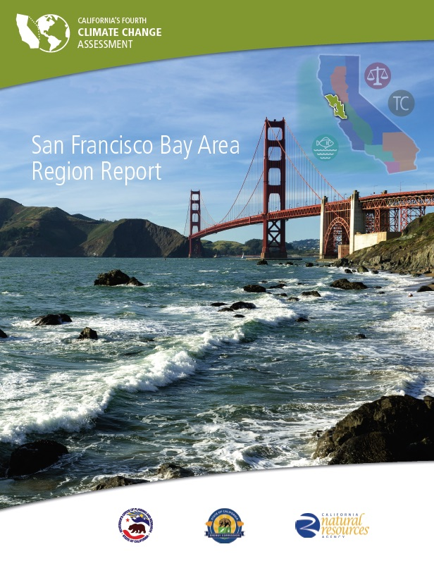
San Francisco Bay Area Region Report CA 4th Assessment David Ackerly, UC Berkeley Mark Stacey, UC Berkeley Andy Jones, Berkeley Lab Jack Chang, UC Berkeley Bruce Riordan, CRI /BayCAN www.climateassessment.ca.gov
Notes:
This report is a primary source for the BayCAN Slide Deck and contains substantial text regarding each topic and image. The report was produced by UC Berkeley faculty and staff for the State of California’s Fourth Climate Change Assessment and was one of nine regional reports produced for the 4th Assessment in 2018. In addition, 3 topical reports were produced on Climate Justice, Oceans and Coasts, and Tribal and Indigenous Communities, as well as a Statewide Summary Report. Finally, the 4th Assessment included 51 “technical reports” on specific climate research topics. All of the reports are available at www.climateassessment.ca.gov.

Slide 3
BayCAN Slide Deck 1. Summary Slides 2. Temperature 3. Precipitation, Drought & Snowpack 4. Wildfires 5. Sea Level Rise 6. Emerging Themes 7. Bay Area Solutions 8. Images
Notes:
TOC for the Slide Deck

Slide 4
1. Summary Slides
Notes:
This section provides overview slides for top-level points in the Bay Area Region Report taken from the Key Findings on pages 6-9.

Slide 5
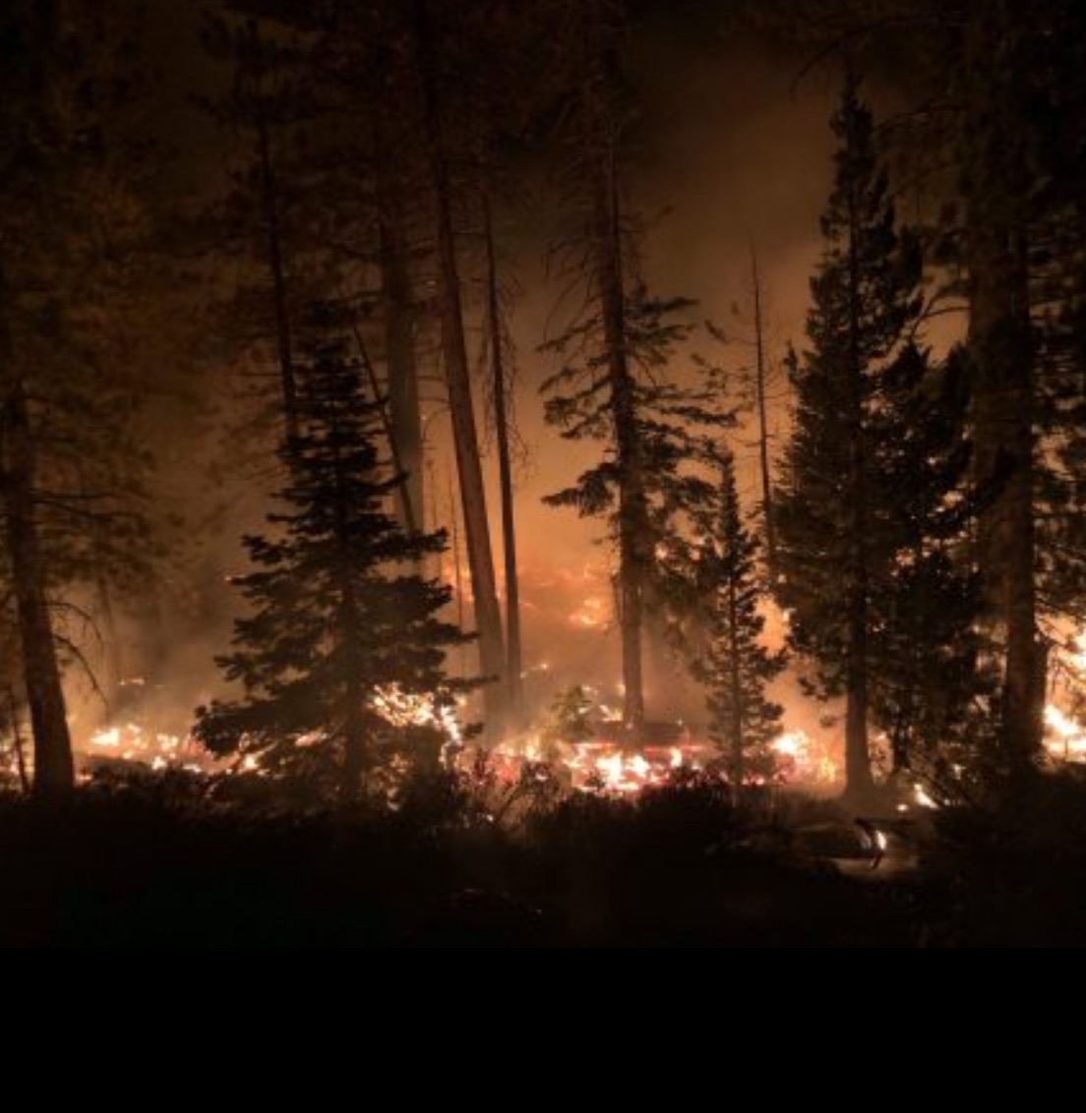
Climate change is already being felt in the Bay Area
Average annual max temperature UP 1.7˚F (0.95 ˚C) 1950-2005.
Coastal fog, so critical to our climate, appears to be less frequent than before.
Sea level in the Bay Area has risen 20 cms. (8 inches) in the last 100 years.
2012-2016 California drought led to the most severe moisture deficits in the last 1,200 years and a 1-in-500 year low in Sierra snowpack.
Fire season in California is longer and fire behavior is changing
Source: California’s 4th Climate Assessment: Bay Area Region Report
Notes:
Examples of how a warming planet is already affecting the Bay Area and California. While a single event like a hot day or an intense rainstorm is the result of complex factors, sometimes including climate change, these longer-term trends are consistent with our knowledge about the impacts of a warmer earth.

Slide 6
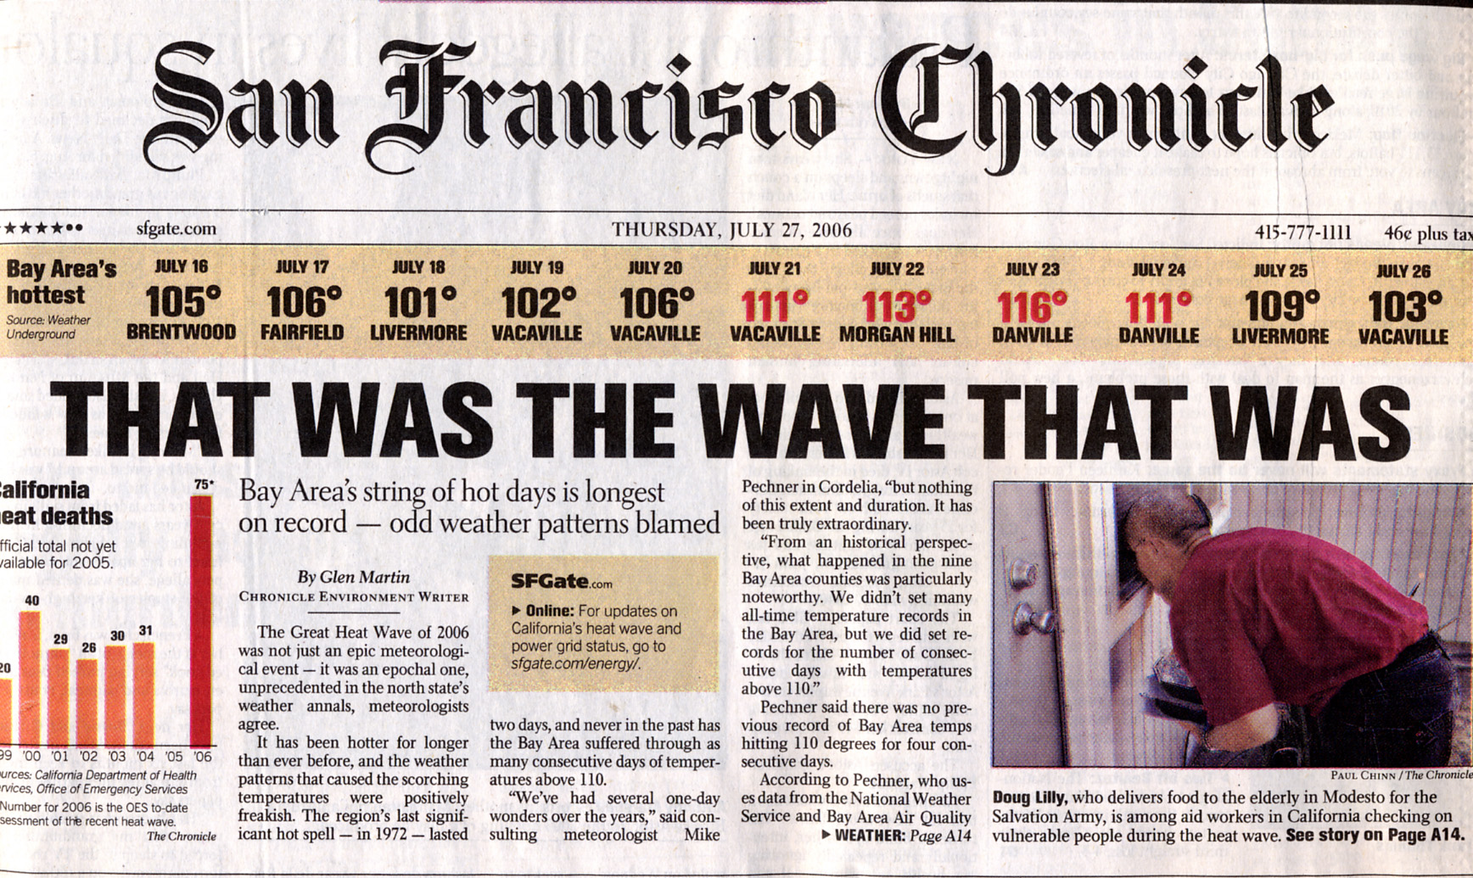
Temp & precip are projected to change significantly
Even with major global efforts to reduce GHGs, Bay Area temperatures will likely rise significantly by 2050.
Precipitation in the Bay Area will continue to exhibit high year-to-year variability - “booms and busts” - with very wet and very dry years.
Future increases in temperature, regardless of whether total precipitation goes up or down, will likely cause longer and deeper California droughts.
Under a high emissions scenario, Sierra Nevada snowpack is projected to decline 20% in the next 2-3 decades, 30% to 60% in mid-century and over 80% in late century.
Source: California’s 4th Climate Assessment: Bay Area Region Report
Notes:
Examples of how a warming planet is projected to affect the Bay Area and California in terms of temperature and precipitation.

Slide 7
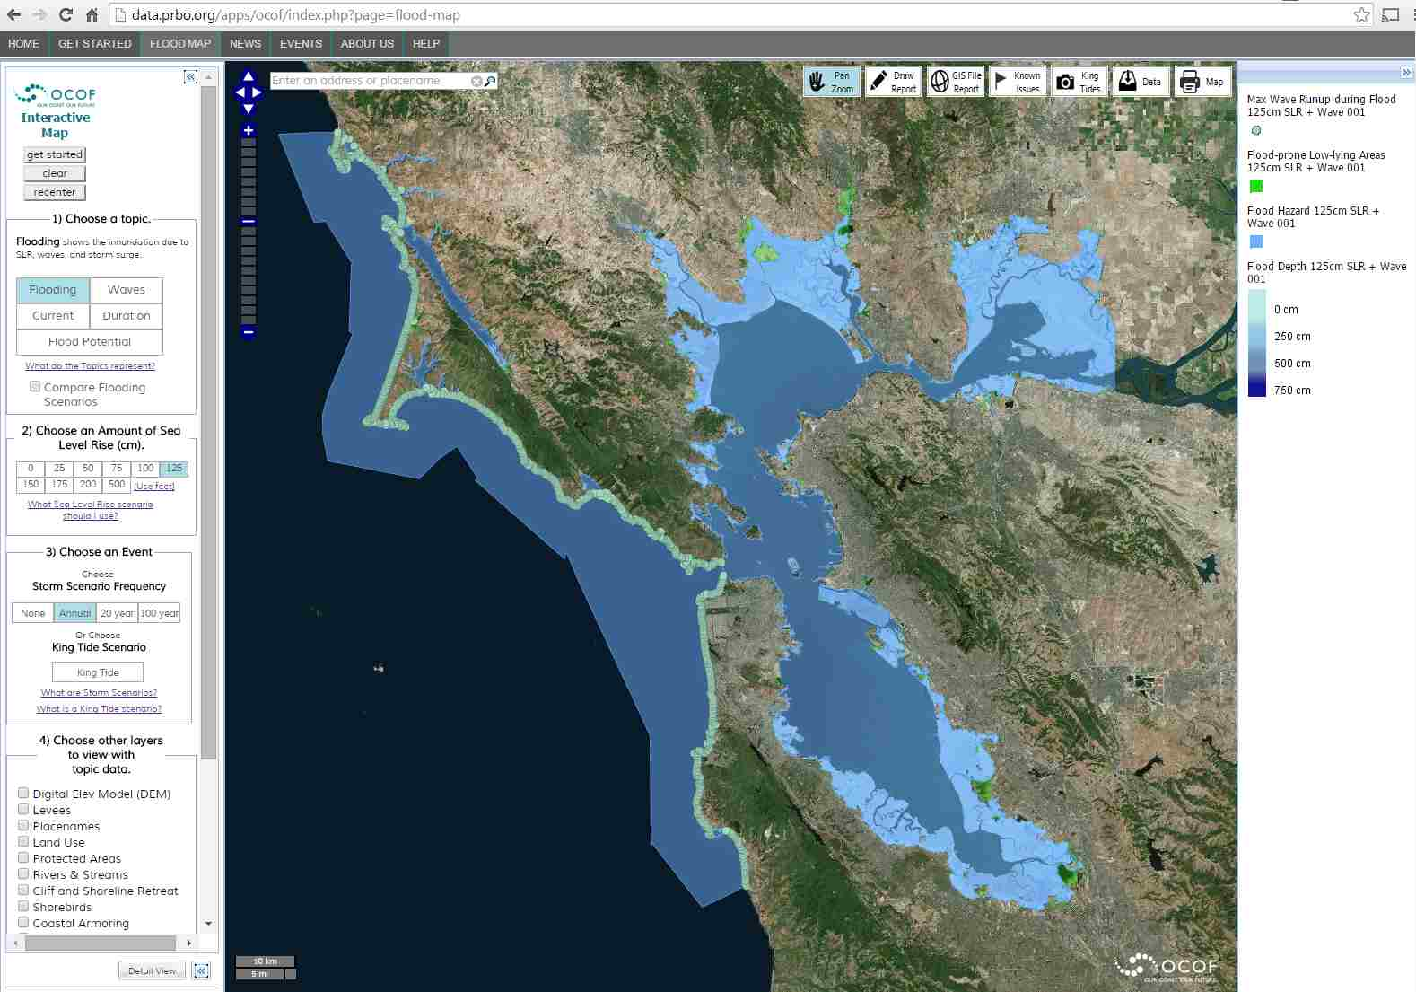
Sea level rise is projected to increase significantly
The 4th Assessment projects median sea level rise in California between 30 inches (RCP 4.5) and 50 inches (RCP8.5) for 2100.
Recent science studies, using advanced models and ice sheet observations, suggest the possibility of extensive loss from Antarctic ice sheets in the 21st century — possibly producing sea level rise by 2100 that could approach 3 meters.
Even with high levels of emissions reductions, research now suggests that at least 2 meters of sea level rise is inevitable over the next several centuries.
Source: California’s 4th Climate Assessment: Bay Area Region Report
Notes:
Examples of how a warming planet is projected to affect sea level rise in the Bay Area and California.

Slide 8
2. Temperature
Notes:
This section shows temperature slides for key temp findings in the Bay Area Region Report pages 13-16 and from other sources.

Slide 9
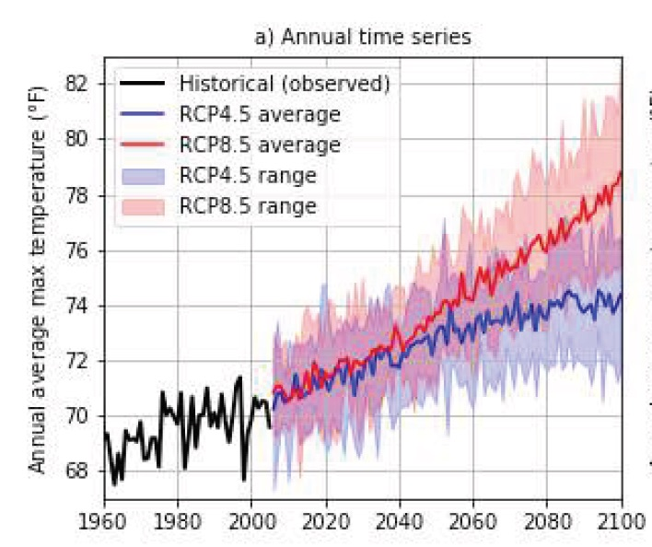
Looking Ahead: Hotter Temperatures
Even with substantial global cuts in GHGs, the Bay Area will see a significant temperature increase by mid-century.
Source: California’s 4th Climate Assessment: Bay Area Region Report
Notes:
The Bay Area Region Report discussion of temperature is on pages 13-16. This chart first shows the historical Bay Area annual average maximum temperature record from 1960 (black line) – some yearly variability but overall trending upward. Then, we show projected annual average max for a moderate emissions scenario (blue - 4.5) and a high emissions scenario (red - 8.5). The scenarios make no real difference in temperature in the next few decades (that warming is already “baked in” from past emissions). However, after 2050 the difference is substantial. (The shaded areas show the potential range under a scenario while the line is the average increase.)

Slide 10
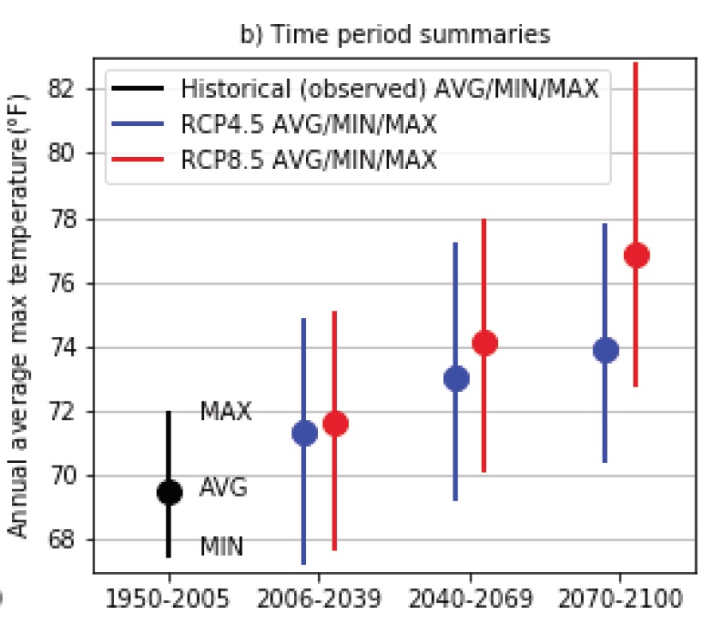
Looking Ahead: Hotter Temperatures
By end of century, lower vs. higher global emissions scenarios will make a major difference in how much Bay Area temperatures rise.
Source: California’s 4th Climate Assessment: Bay Area Region Report
Notes:
This is another way to illustrate the temperature increases. Again, the 4.5 vs. 8.5 scenarios start to make a difference in mid-century and make a substantial difference late in the century. In this chart, the dot is the average temperature and the bars show the possible range. For example, in 2070-2100 the range of possible temperatures is just over 70˚F to almost 78˚F in the 4.5 scenario while the average projected temp is 74˚F.

Slide 11
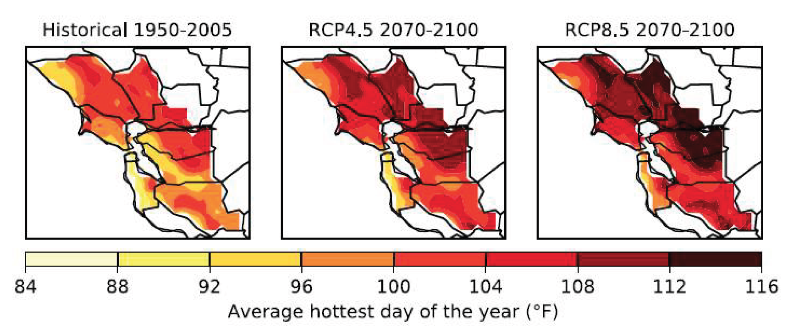
Looking Ahead: Hotter Hottest Day of the Year
The hottest day of the year in the Bay Area will be significantly hotter in the latter part of the century.
Source: California’s 4th Climate Assessment: Bay Area Region Report
Notes:
Average temperatures can be hard to relate to, so these maps show how the Hottest Day of the Year in different parts of the Bay Area will get a LOT hotter under two different emissions scenarios. See the temperature bar below the upper maps.

Slide 12
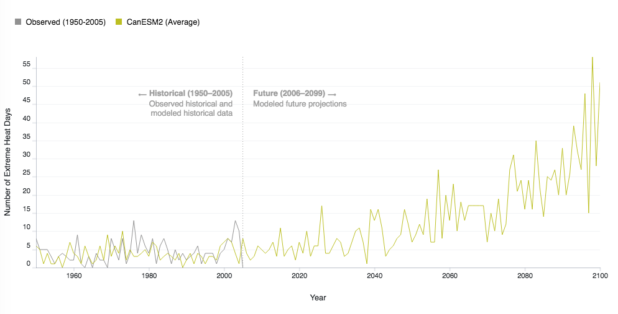
Looking Ahead: Many More Hot Days in __________
There will be many more VERY HOT DAYS as we live through the next decades.
Source: Cal-adapt.org
Notes:
This chart was made for Berkeley with the easy-to-use Extreme Temperature Tool at Cal-Adapt.org. You can make such a chart for any city in the Bay Area. It shows the number of days over a certain ”extreme heat” temperature for a given city. Each threshold is based on the historical record for that city. Go to Cal-adapt.org and click on the Extreme Heat tool. Click on the “change location” button and fill in the name of your city, then click “update chart” and the data and chart for your city will load. This will include the exact “extreme heat” threshold for your city. Select 4.5 or 8.5 scenario (I use the 8.5 since that is “business as usual.”) To simplify the graph, deselect 3 of the 4 given global climate models (GCMs) on the left side of the page and use just the CanESM2 (average) GCM. Finally, click Save Chart which will put it on your desktop. Then, use Preview or other software to make a “snapshot” of the chart for your slide.

Slide 13
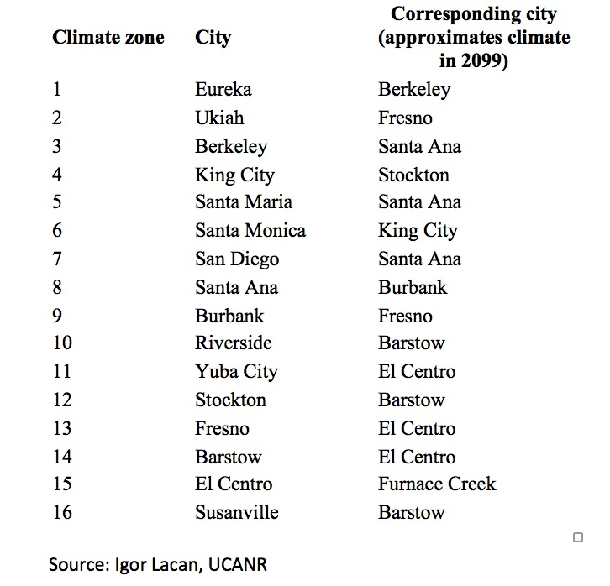
Looking Ahead: Where’s Your Future City?
The climate of all California cities will change rather dramatically by the end of the century under a high emissions scenario.
Source: McBride and Lacan 2018
Notes:
This chart is from a new study on street trees by Igor Lacan at UC Cooperative Extension and Joe McBride at UC Berkeley. The two researchers looked at a city in each of 16 California climate zones and then charted which city they would likely resemble climate-wise in 2099. It gives a clearer, real-world picture of how much a city will warm up by the end of the century. The researchers used this data to inform today’s street tree selection in Central Valley cities. For example, looking at which trees are doing well (or not) today in El Centro will be helpful to Fresno’s choosing of street trees for the coming decades. See the link to the study at: https://www.sciencedirect.com/science/article/pii/S1618866718300013?via%3Dihub#! and the tree results at: https://ucanr.edu/sites/Igor/Street_Trees_and_Climate_Change/

Slide 14
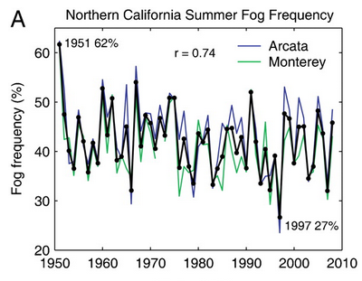
Looking Ahead: Fog Decline?
Several studies suggest that coastal fog along the California coast, so critical to our Bay Area climate, is less frequent than before.
However, the causes of this decline and implications of climate change are unclear because coastal fog formation is a complex process.
Source: Johnstone Dawson 2010
Source: California’s 4th Climate Assessment: Bay Area Region Report
Notes:
Based on discussion on the current (somewhat undecided) scientific inquiry into what has happened to fog along our coast on pages 25-27. This has high importance for future Bay Area temperatures, particularly at the coast. The chart is from one of the UC Berkeley studies cited in the regional report. That study can be found at: https://www.pnas.org/content/pnas/107/10/4533.full.pdf

Slide 15
3. Precipitation, Drought and Snowpack
Notes:
This section is based on discussion in the Bay Area Region Report pages 17-25 and from other sources.

Slide 16
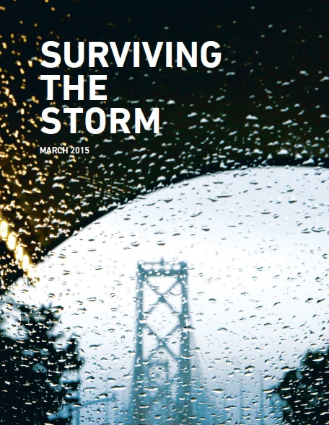
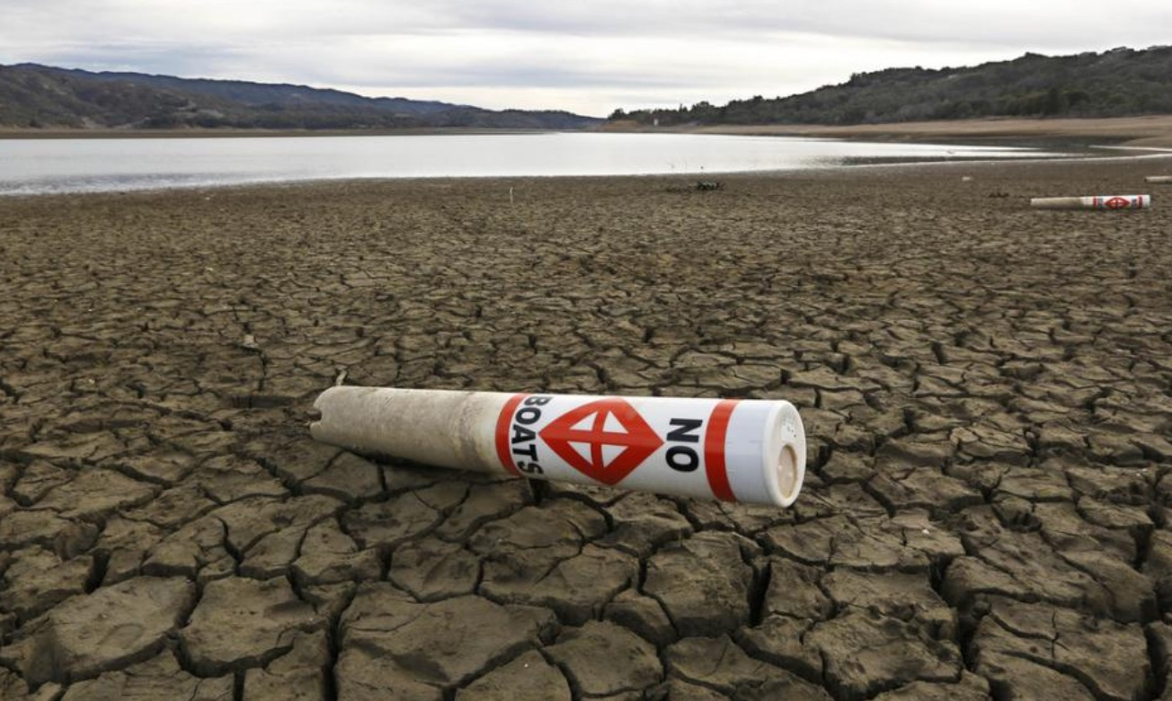
Looking Ahead: Very WET and Very DRY
The Bay Area will continue to experience high year-to-year variability - “booms and busts” - with very wet and very dry years.
Source: California’s 4th Climate Assessment: Bay Area Region Report
Notes:
While AVERAGE annual precipitation for our region is not projected to vary much (models show a slight increase by the end of the century) the variability of each year will continue to be high. We are projected to get more very wet years and more very dry years, producing management problems for agriculture, urban water supplies and ecosystems. From the report page 17: California precipitation is the most episodic in the nation, often with relatively long duration between storms. As a result, large, discrete storms provide a substantial fraction of California’s rainy season total precipitation, and annual precipitation is highly variable from year to year.”

Slide 17
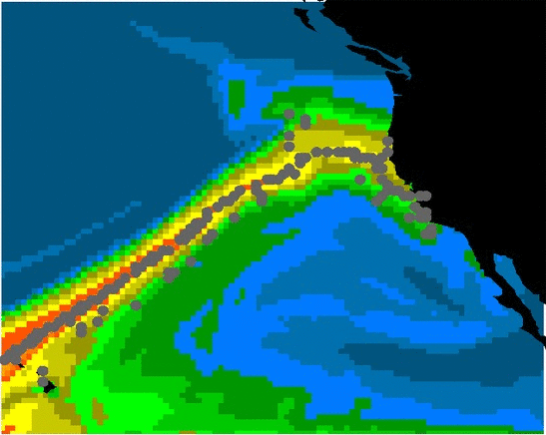
Looking Ahead: Atmospheric Rivers
Our largest winter storms will likely become more intense and more damaging.
Source: California’s 4th Climate Assessment: Bay Area Region Report
Notes:
Atmospheric rivers (what we used to call the “pineapple express”) are projected to become more intense and potentially cause more flooding damage to our region. The basic science behind this (warmer air can hold more water) is explained on page 18-20. From the report page 20: “...what is currently considered a 20-year return frequency one-day storm event for the Bay Area would increase in frequency by a factor of three or more by end of century. In other words, a once-in-20-
year storm would become a once-in-seven-year or more frequent storm. Similarly, Swain et al. (2018) estimate that
a once-every-200-year sequence of storms comparable to that which caused the great California flood of 1862 could
occur every 40-50 years by 2100 under a high emissions scenario.”

Slide 18
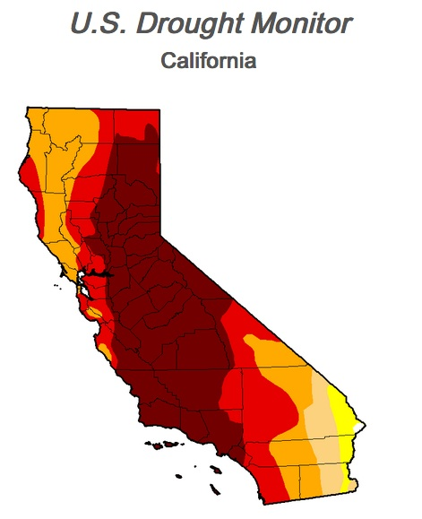
Looking Ahead: Longer & Deeper Droughts
Increases in temperature, regardless of whether total precipitation goes up or down, will likely cause longer and deeper California droughts.
Source: California’s 4th Climate Assessment: Bay Area Region Report
Notes:
See the science on this on page 21-22. From page 22: In recent years, the contribution of anthropogenic climate change to the intensity and persistence of drought has been a major topic of interest (Diffenbaugh et al. 2015; Mann & Gleick 2015; Seager et al. 2015; Swain 2015; Cheng et al. 2016; Ang.lil et al. 2017). Most of the studies have concluded that current and future increases in temperature, regardless of changes in precipitation, raise the probability of enhanced drought magnitude and duration in California (Wehner et al. 2017). The map is from 2015 showing the hardest hit drought areas in the state (darker red).

Slide 19
Looking Ahead: Shrinking Sierra Snowpack
High emissions scenario: Sierra snowpack projected to decline by 20% next 2-3 decades, 30% to 60% mid-century and over 80% in late century.
DJF
SWE
(mm)
Source: California’s 4th Climate Assessment: Bay Area Region Report
Notes:
The Sierra snowpack is our state’s greatest reservoir. The snowpack accounts for at least one-third of our annual water supply. With rising temperatures, the snowpack will be affected in two ways. First, more winter precipitation will fall as rain rather than snow. Second, snow will melt earlier in the Spring. In both cases, reservoirs will often need to discharge water earlier in the year instead of holding precious supplies until the hot and dry summer and fall months. The chart shown here is explained on page 25.

Slide 20
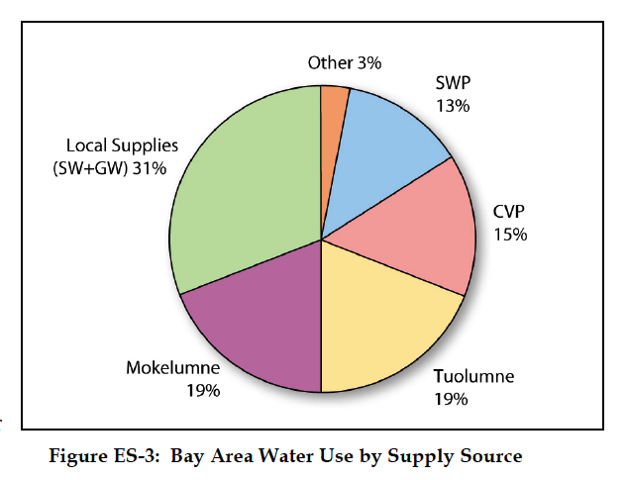
Looking Ahead: Shrinking Sierra Snowpack
Bay Area is heavily dependent on Sierra snowpack for water supply. Only Marin and Sonoma are not directly connected to the Sierra
Source: California’s 4th Climate Assessment: Bay Area Region Report
Notes:
The Bay Area is very dependent on Sierra snowpack for our water supply. Tuolumne = SF and its partners in San Mateo and Santa Clara counties. Mokelumne = EBMUD (much of the East Bay). CVP Central Valley Project (feds) and SWP State Water Project feed Delta and some Bay Area systems. Local supplies (surface water and ground water) are used everywhere but dominant in Marin and Sonoma.

Slide 21
4. Wildfires
Notes:
This section is based on key points in the Bay Area Region Report on pages 27-30 and from other sources.

Slide 22
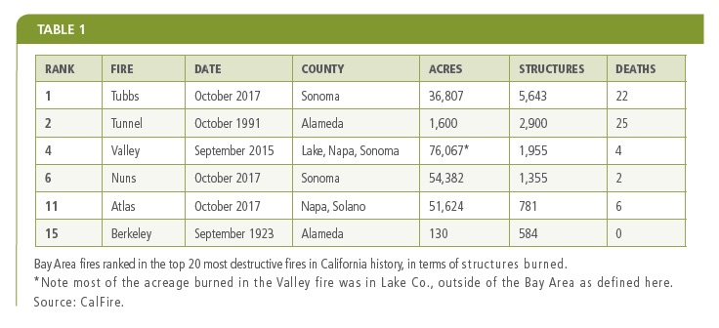
Looking Ahead: More Intense Wildfires
Hotter, drier conditions will provide the context for an increase in fires and more intense fires
Future fire activity will be driven by both changes in urban development and changes in climate.
Source: California’s 4th Climate Assessment: Bay Area Region Report
Notes:
The chart (now slightly dated) shows that the Bay Area, through 2017, has experienced 4 of the largest fires in state history in terms of structures burned and 6 of the top 20. The 2018 Camp Fire in Butte County is now #1 for structures and fatalities in California history. The 2018 Carr Fire in Redding consumed over 1,600 structures. The discussion on pages 27-30 explains that future fire risk for the Bay Area depends on both climate change (hotter, drier conditions) AND how we develop housing at the urban fringe.

Slide 23
5. Sea Level Rise
Notes:
This section is based on pages 31-33 in the Bay Area Region Report and other sources.

Slide 24
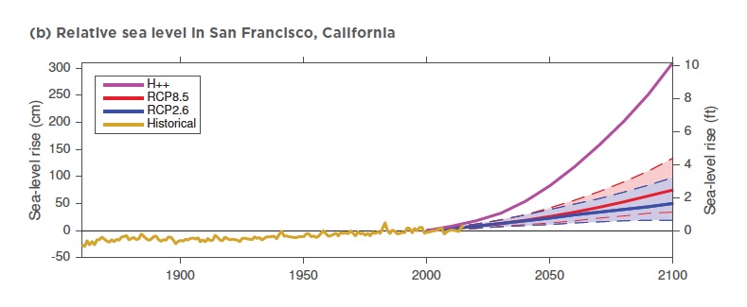
Looking Ahead: Sea Level Rising
California’s 4th Assessment projects median sea level rise for 2100 of 30 inches (RCP 4.5) or 50 inches (RCP8.5).
Recent studies suggest the possibility of extensive loss from Antarctic ice sheets in the 21st century — possibly producing sea level rise by 2100 approaching 10 feet.
Even with high levels of emissions reductions, research now suggests that at least 6-7 feet of sea level rise is inevitable over the next several centuries.
Source: California Ocean Protection Council
Source: California’s 4th Climate Assessment: Bay Area Region Report
Notes:
See the rather detailed discussion of SLR on pages 31-33. We cite the latest projection from the State of California’s 4th Assessment (Pierce et al 2018) for two emissions scenarios (moderate 4.5 and high 8.5) but also note the California Ocean Protection Council’s discussion of the recent research raising the “physical plausibility” of much greater SLR due to large ice sheet melting in Antarctica. We also note research on an “inevitable” increase of nearly two meters in the coming centuries as sea level rise will continue long after we have cut emissions or even brought them to net zero. From a 2018 Oregon State report published after the Bay Area Region Report was completed: "When we pump more carbon into the atmosphere, the effect on temperature is almost immediate," said Peter Clark, an Oregon State University climate scientist and lead author on the study. "But sea level rise takes a lot longer to respond to that warming. If you take an ice cube out of the freezer and put it on the sidewalk, it doesn't melt immediately. The same is true for ice sheets. It takes time for them to melt so that the resulting sea level rise will continue for hundreds to thousands of years after we're done emitting carbon."

Slide 25
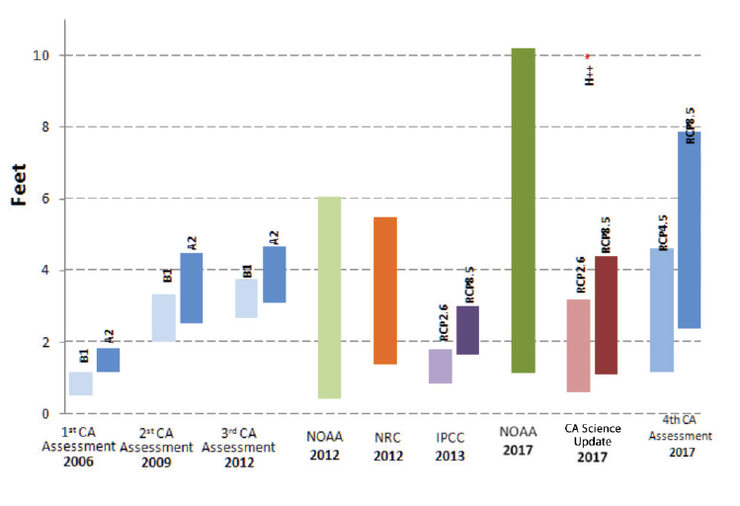
Looking Ahead: Sea Level Rising
A series of sea level rise projections for California have been produced by state and federal scientists for more than a decade.
Source: California Ocean Protection Council
Notes:
This chart is from page 35 in “Rising Seas in California” the science report produced in 2018 for the Ocean Protection Council. It shows a number of SLR projections over the years concerning California’s coastline and UNDERSCORES the considerable uncertainty in each of the projections, due to our still limited understanding of how large ice sheets in Antarctica will behave in a warmer climate. The H++ scenario for the “physical plausibility” of 10 feet of SLR is marked above the “CA Science Update 2017.”

Slide 26
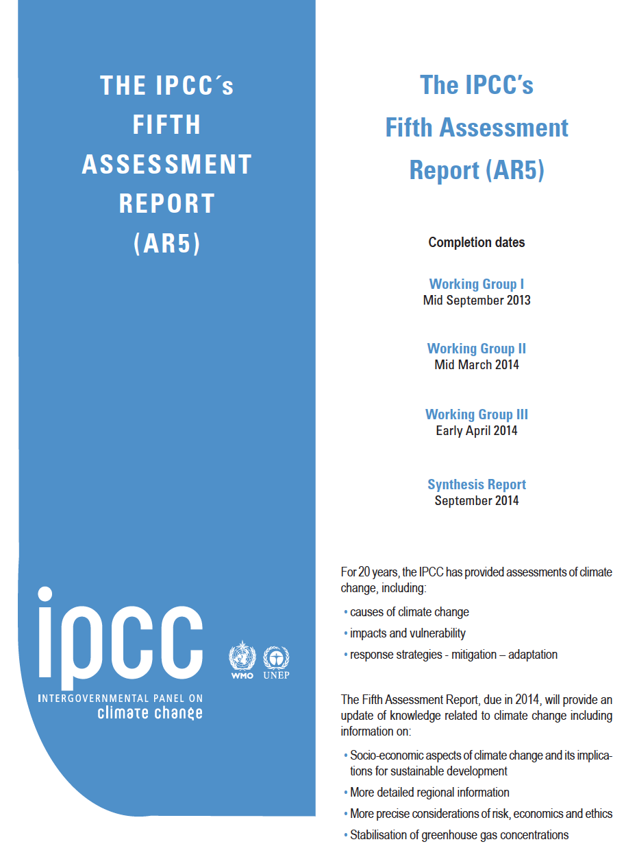
David Wallace-Wells on UNCERTAINTY
“All climate change is governed by uncertainty, mostly the uncertainty of human action—what action will be taken, and when, to avert or forestall the dramatic transformation of life on the planet that will unfold in the absence of dramatic intervention. Each of our projections, from the most blasé to the most extreme, comes wrapped in doubt—the result of so many estimates and so many assumptions that it would be foolish to take any of them, so to speak, to the bank.”
Notes:
An example of what we can provide on key questions like UNCERTAINTY.

Slide 27
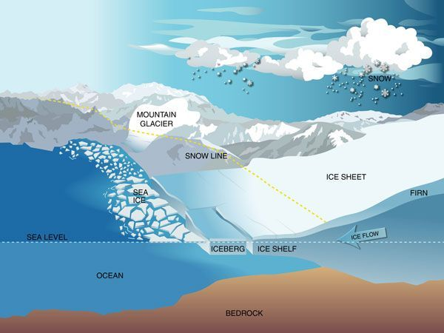
But sea level rise is different, because on top of the basic mystery of human response it layers much more epistemological ignorance than governs any other aspect of climate change science, save perhaps the question of cloud formation. When water warms, it expands: this we know. But the breaking-up of ice represents almost an entirely new physics, never before observed in human history and therefore only poorly understood.
David Wallace-Wells
The Uninhabitable Earth: Life After Warming

Slide 28
6. Emerging Themes
Notes:
This section temperature slides for key points in the Bay Area Region Report and from other sources.

Slide 29
Theme #1. Our global success (or not) in cutting carbon pollution will make a significant difference in Bay Area climate impacts after 2050.
Notes:
There is a significant lag in the climate system between when GHGs are emitted into the atmosphere and when we see the impacts (warmer temperatures, more intense storms, rising sea levels, etc.). This is mostly because the oceans absorb much of the heat produced. The impacts we are seeing now and for the next few decades are the result of PAST emissions that are already “baked in” the global system. Therefore, cutting emissions now will only start to make a visible difference around mid-century and beyond. Cutting emissions is VITAL to reducing warming later this century. How much we cut and how soon will determine the type of world we inhabit in 2050 and beyond.

Slide 30
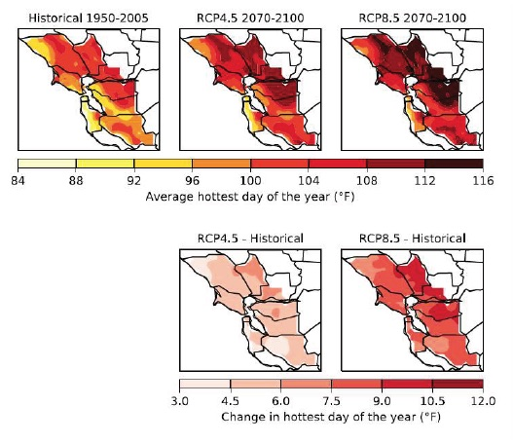
Source: California’s 4th Climate Assessment: Bay Area Region Report
Notes:
These charts illustrate the point made in the previous slide. Which emissions path we choose over the next few decades will have a huge impact on the future world. While our actions to cut emissions now can’t have any real impact on climate impacts through mid-century, but they will definitely make a difference in the second half of the 21st century and beyond.

Slide 31
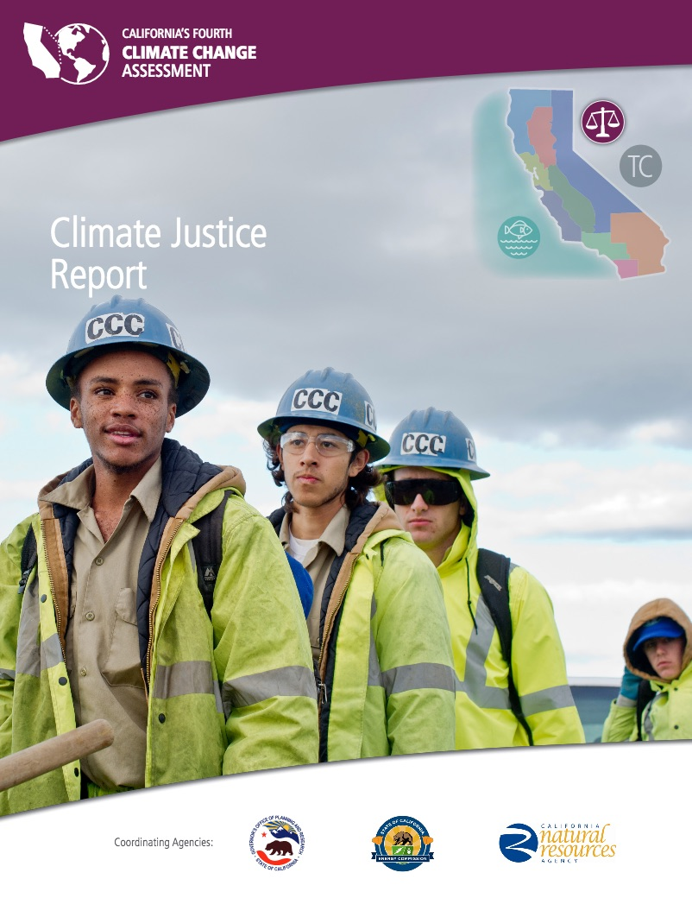
Theme #2. While everyone in the Bay Area will be seriously affected by climate impacts, vulnerable populations/communities will be hit harder and will have a tougher time recovering.
Notes:
The Bay Area Region Report and the statewide Climate Justice Report both discuss the ways in which climate change will impact vulnerable communities—low income, people of color, elderly, etc. The 90-page Climate Justice report involved a number of Bay Area advisors and reviewers.

Slide 32
“While all Californians are impacted by climate change, climate change does not affect all people in the same way. These frontline communities are particularly vulnerable to the impact of climate and environmental changes because of decades-long, pervasive socio-economic conditions that are perpetuated by systems of inequitable power and resource distribution. Those systems, in turn, are the result of intentional decisions by people in positions of power and deeply institutionalized racism and class bias. These conditions and systems have left California’s frontline communities with unsafe, unhealthy neighborhoods and limited access to quality education, public services, and economic opportunities.” — “Advancing Climate Justice in California,” Climate Justice Working Group
Source: California’s 4th Climate Assessment: Climate Justice Report
Notes:
This quote is from the introduction to the 4th Assessment’s Climate Justice Report.

Slide 33
Climate justice is defined as “the concept that no group of people should disproportionately bear the burden of climate impacts or the costs of mitigation and adaptation” (Cooley 2012).
Source: California’s 4th Climate Assessment: Climate Justice Report
Notes:
Definition from the Climate Justice report.

Slide 34
Social, economic, and environmental factors that impact climate vulnerability: -- Race/Ethnicity -- Lack of access to financial resources -- Urbanization (heat island effect) -- Existing disproportionate impacts from other pollutants -- Existing high rates of health issues -- Lack of access to good health care -- Disparities in education and limited English proficiency (LEP) -- Employment in jobs and industries disproportionately impacted -- Lack of access to air conditioning and transportation -- Lack of social capital -- Citizenship and immigration status Source: California’s 4th Climate Assessment: Climate Justice Report
Notes:
Definition from the Climate Justice report.

Slide 35
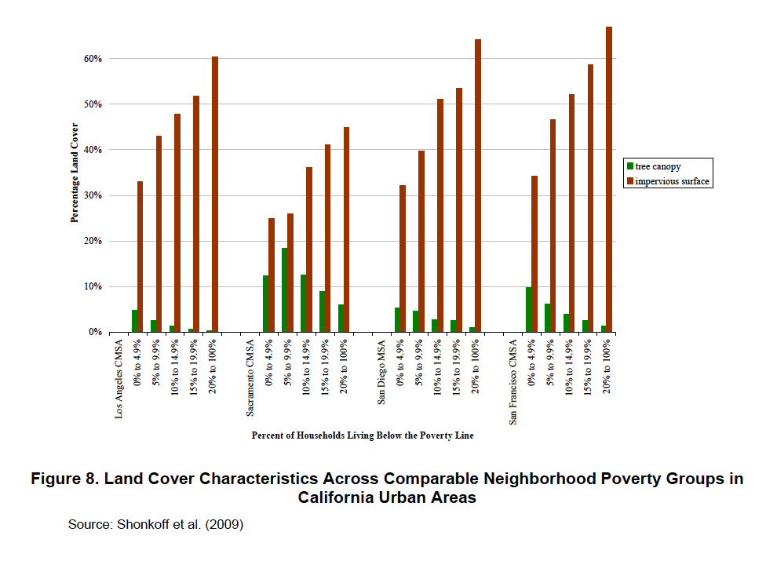
Notes:
This is an example of research done in the Bay Area (and 3 other CA regions) to illustrate climate-related inequities. This study by Shonkoff et al shows the difference in tree canopy (more shade, less heat) in green and the extent of hard, impervious surfaces (more reflected heat) in red comparing neighborhoods at different income levels (percent of households below the poverty line).

Slide 36
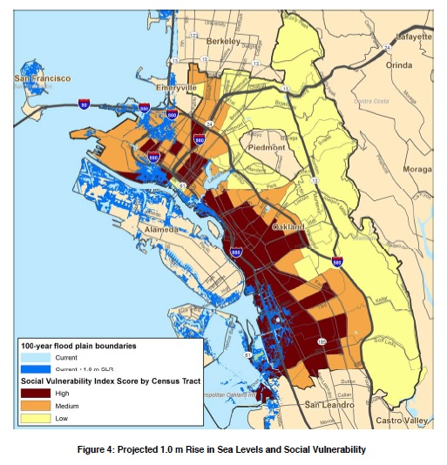
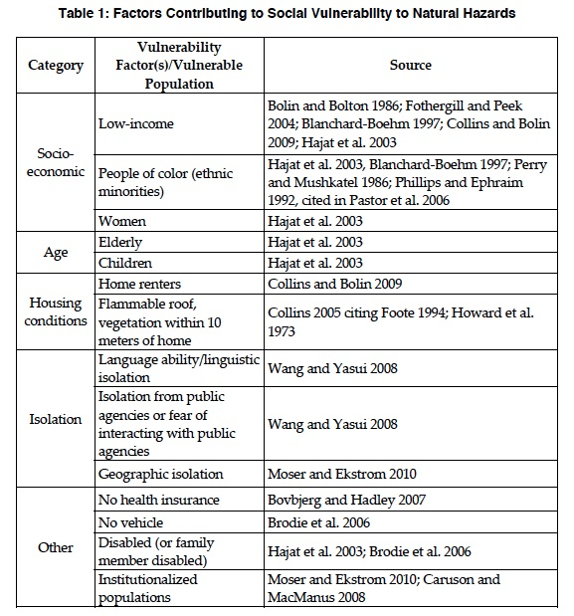
Source: Community-Based Planning: A Case Study of Oakland, Pacific Institute, 2012
Notes:
More research on climate-related inequities. The chart on the left was developed to measure social vulnerability. While the map on the right overlay high social vulnerability areas in Oakland (dark red/brown) with places that would flood under a meter of sea level rise. Both graphics (and more like the latter) are from Community-Based Adaptation Planning: A Case Study of Oakland, California by the Pacific Institute in 2012.

Slide 37
Theme #3. Land use decisions will be critical to increasing (or decreasing) the Bay Area’s ability to adapt to climate change and to build a more resilient region.
Notes:
This theme is woven through the report. Our ability to deal effectively with fire, sea level rise, heat, drought and other climate impacts will be heavily dependent on what housing, land use and development patterns we employ over the next few decades. Where will we house the next 1 million residents expected to live in the Bay Area in another decade or two?

Slide 38
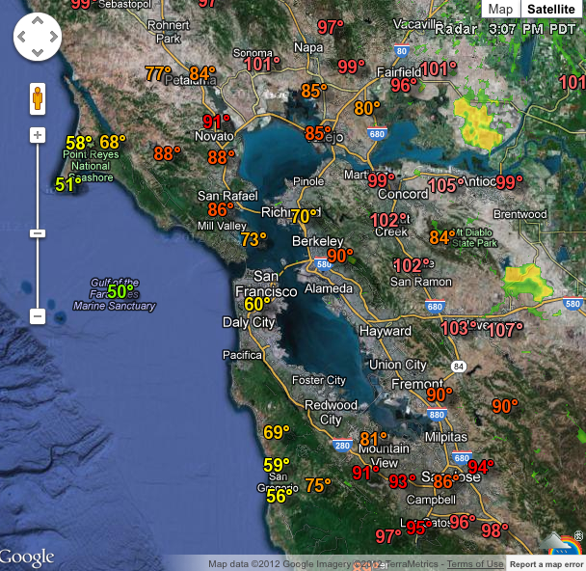
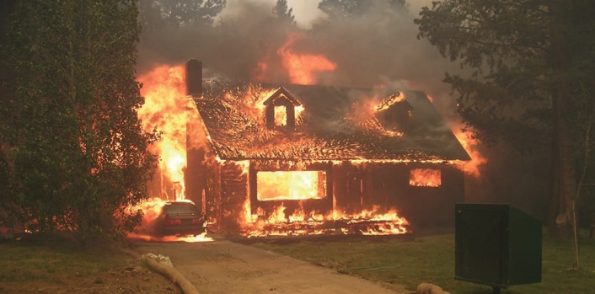
Notes:
Images to illustrate the land use issues related to climate change. The top left is from Our Coast Our Future and shows 4 feet of sea level rise flooding significant bayside and coastal lands. The top right is from a Google map for Bay Area next day temperatures showing the huge difference in afternoon temperatures from the coast to central bay to outer Bay Area. Hotter areas use more water in summer and more electricity for AC. The bottom image shows a structure fire, typical of what we see now in what were once rural open spaces.

Slide 39
7. Bay Area Solutions
Notes:
This section shows examples of the many projects underway to address climate impacts in the Bay Area.

Slide 40
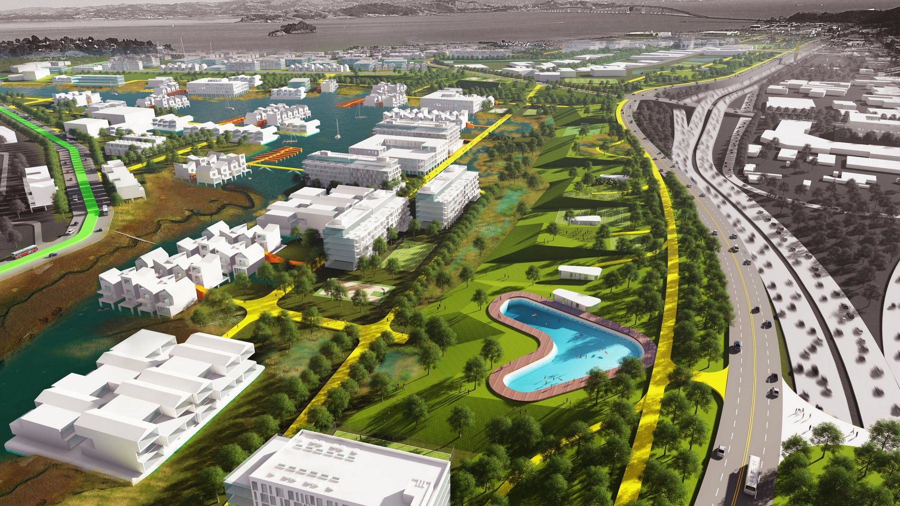
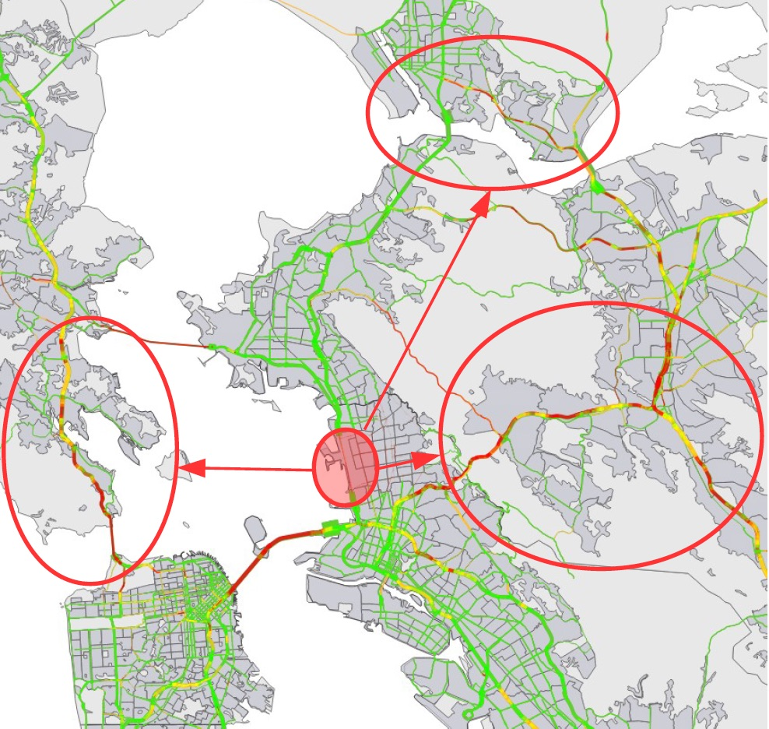
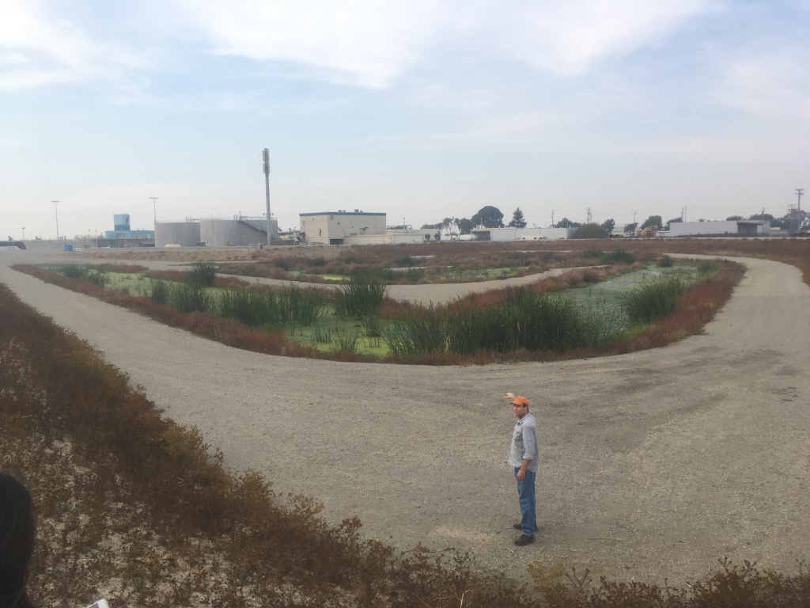
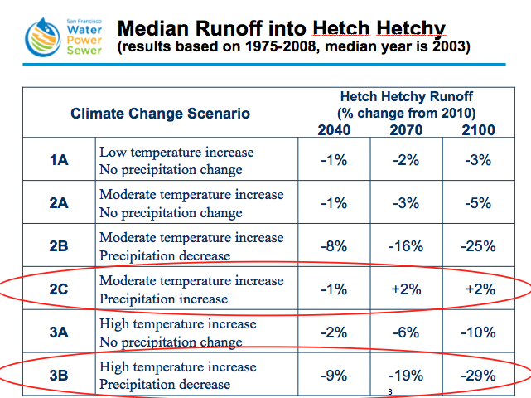
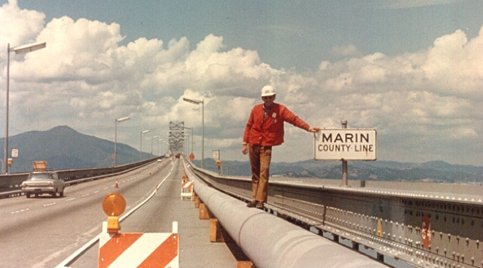
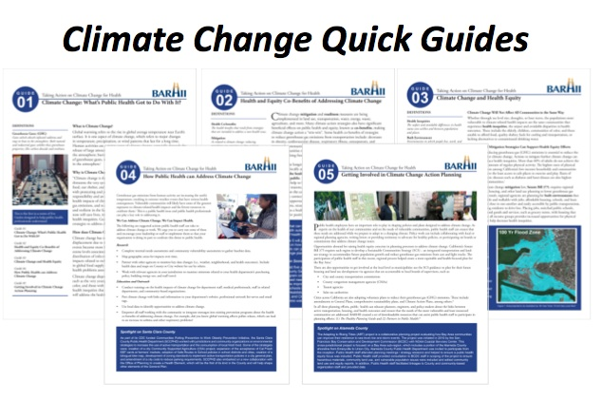
Notes:
Clockwise from upper left: Big CDC-funded project by SF. Resilient by Design. Mark Stacey RISeR research project at UC Berkeley. Late 1970’s water supply pipe laid down on the Richmond San Rafael Bridge to bring East Bay water to Marin during a deep drought. BayCAN. Post-2017 fire/water project in North Bay. SFPUC projections for Hetch Hetchy water supply under various climate scenarios. BARHII Climate Change/Health Guides. Oro Loma Horizontal Levee Project in East Bay.

Slide 41
1st Regional Parcel Tax (ever) - $500M
Notes:
Measure AA regional parcel tax. 1st regional parcel tax passed in California. Will provide $500 million over 20 years for SF Bay wetlands restoration projects.

Slide 42
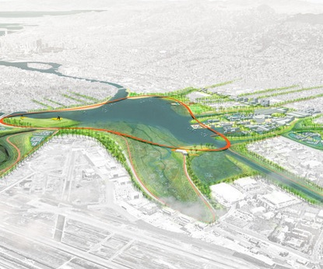
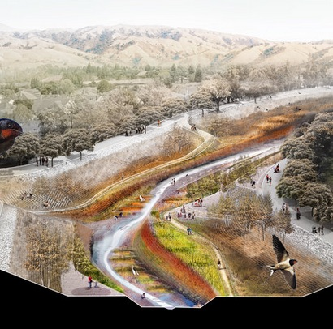
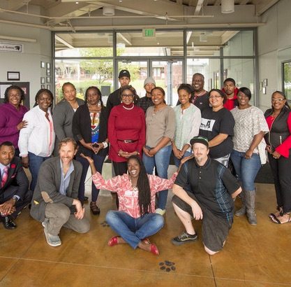
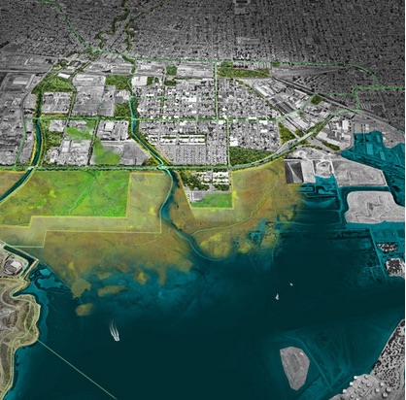
Resilient by Design: Bay Area Challenge
Source: Resilient by Design: Bay Area Challenge
Notes:
Resilient by Design: Bay Area Challenge. Year-long project funded by $5 million grant from Rockefeller Foundation that produced 9 visionary designs for addressing sea level rise in specific locations around the bay. More at: http://www.resilientbayarea.org/

Slide 43
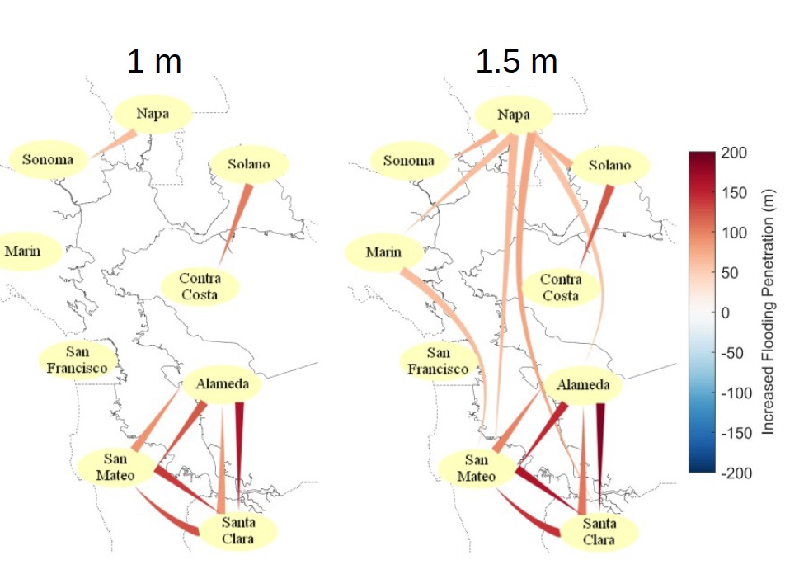
Research: RISeR SF Bay — UC Berkeley
Source: RISeR SF Bay – Mark Stacey, UC Berkeley
Notes:
Research by Mark Stacey and colleagues at UC Berkeley showing the inter-dependence of local communities around the bay in dealing with sea level rise. The left panel illustrates, for 1 meter and 1.5 meters of sea level rise, where a given county fortifying itself (walls or levees) will have an impact on water levels in nearby counties. The effects are greatest in the South Bay.

Slide 44
8. Images
Notes:
This section provides images related to Bay Area climate impacts that can be used in slide shows.

Slide 45
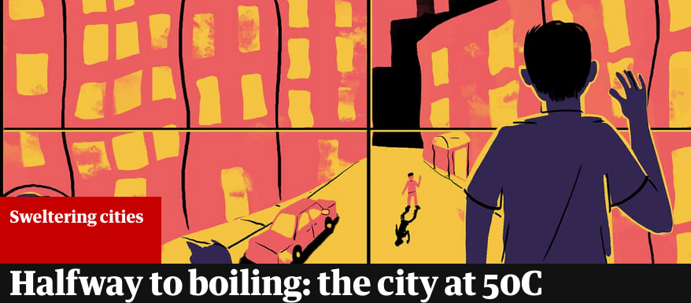
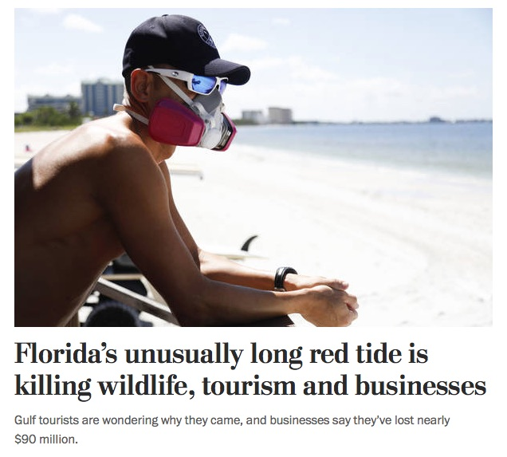
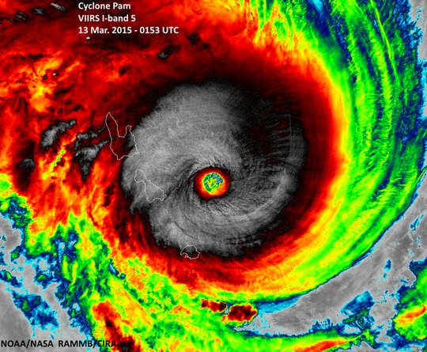
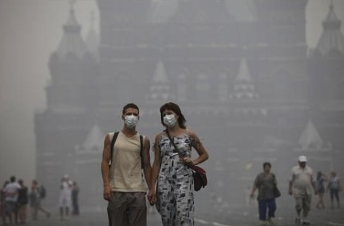
Notes:
BRUCE

Slide 46
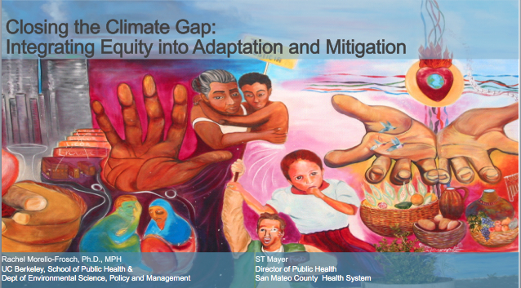
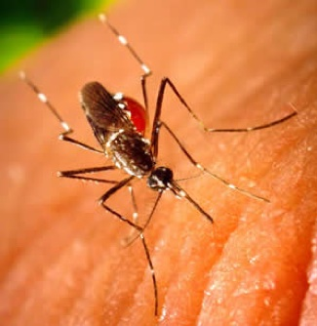
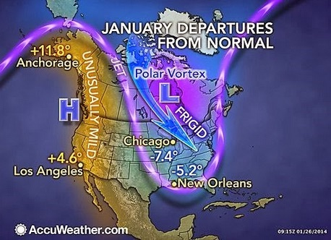
Notes:
Clockwise from upper left: An image from a slide presentation by Rachel Morello-Frosch, UC Berkeley expert and co-author of The Climate Gap (climate, health and equity). San Francisco Chronicle headline from a major heatwave that hit Northern California in 2006. An chart showing how the Polar Vortex in early 2018 dropped temperatures way below normal in the Upper Midwest. The non-native Aedes Egypti mosquito, which has been found in the Bay Area as recently as 2015, can carry dengue, yellow fever and zika.

