Slide 1
BayCAN Regional Meeting February 3, 2021 9:00 am – Noon

Slide 2
Agenda
Welcome and Agenda Review
Pathways to Equity (breakouts)
The Drought is (likely) Here, the Heat is Coming
Climate Science 1: the Pacific Decadal Oscillation is Shifting
Cultivating Personal Resilience (breakouts)
break
BayCAN Membership for Year 4
Climate Science 2: Global Actionable Science for Bay Area Planning
Sacramento 2021 Legislation and Bay Area Adaptation Planning
News — Bay Adapt, NorCal Resilience, Governor’s Budget and more

Slide 3
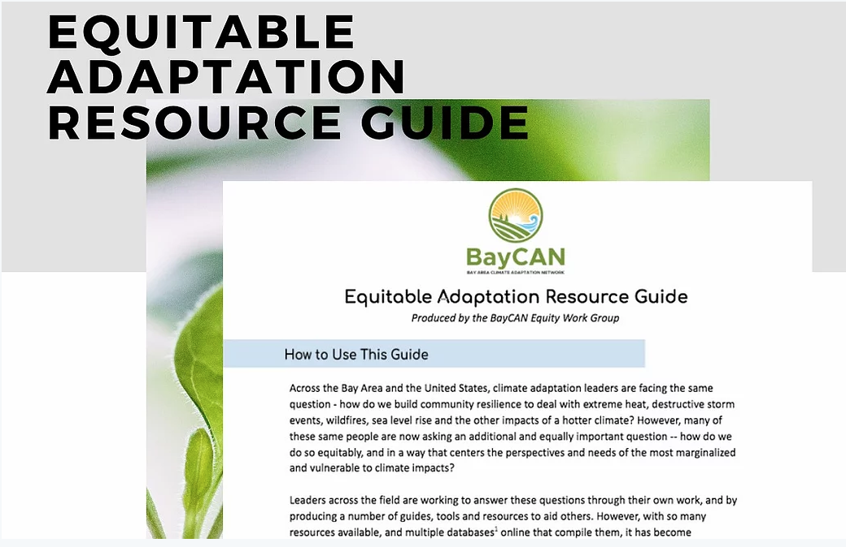
Pathways to Equity:
6 Phases of the Equitably Adaptation Process
As outlined in BayCAN’s Equitable Adaptation Resource Guide

Slide 4
Pathways to Equity:
The 6 Phases of the Equitably Adaptation Process
As outlined in BayCAN’s Equitable Adaptation Resource Guide
Phase 1: Making the Case for Equity - w/ Hannah Doress
Phase 2: Leadership and Power-Shifting - w/ Phoenix Armenta
Phase 3: Funding Equity Equitably - w/ Shalini Kannan
Phase 4: Vulnerability Assessing & Mapping - w/ Jaclyn Mandoske
Phase 5: Plan Drafting & Identifying Solutions - w/ Hoi-Fei Mok
Phase 6: Measuring and Analyzing for Equity - w/ Yeshe Salz

Slide 5
First, HEAR FROM A COLLEAGUE:
an example of “what works”
Then go around and answer:
What is a strategy that has worked for you or that you would like to try to advance equity in this phase of the planning process?

Slide 6
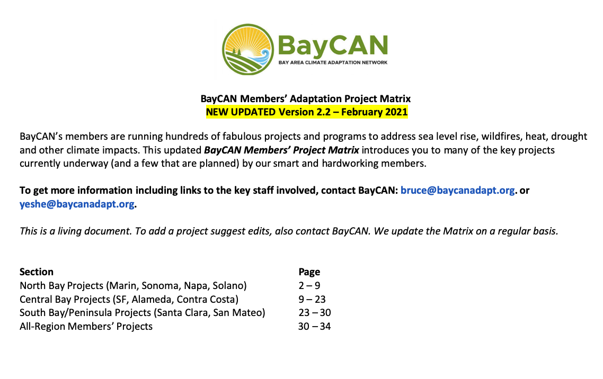
The Drought is here, the Heat is Coming
Introducing the 2021 BayCAN Project Matrix!

Slide 7
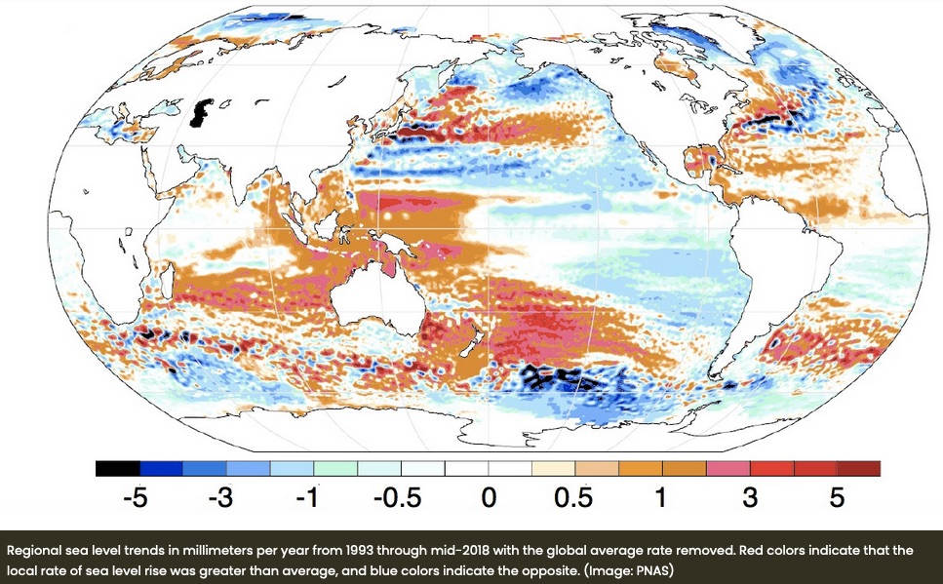
Climate Science 1: The PDO is Shifting

Slide 8

Cultivating Personal Resilience:
An Exercise to Open to Our Experience

Slide 9
Exercise: Open Sentences
Breakout groups of 3….
• 3 mins: Introductions
Name, Pronouns, How are you feeling today? (come as yourself!)
• 4 minutes per person:
“One thing I love about being alive on earth today is ______” x3
….
…
….

Slide 10
Break-time!

Slide 11
Climate Science 2: Global Actionable Science for Bay Area Planning

Slide 12
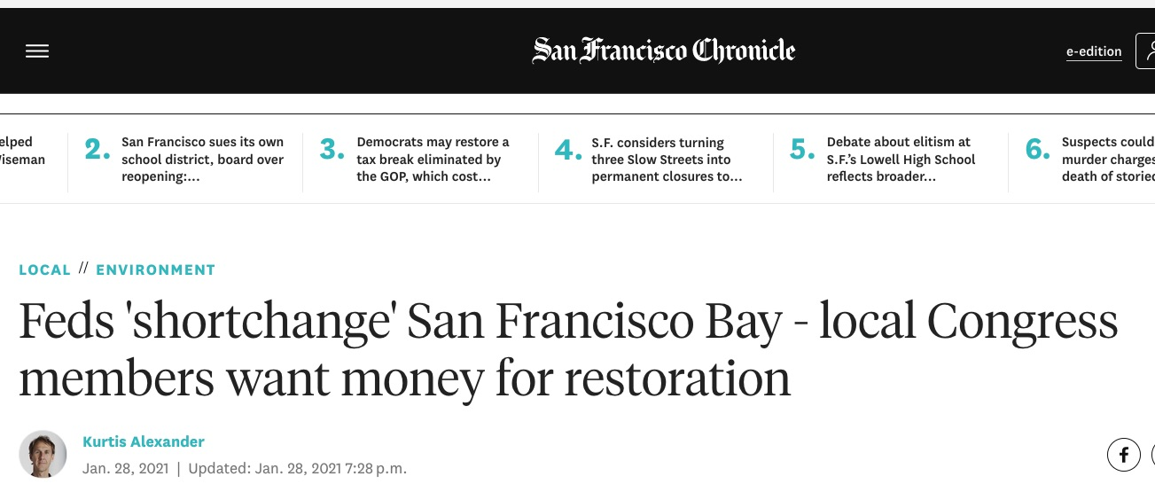
2021 Legislation and Bay Area Adaptation

Slide 13
Your Priorities: How State $$ can best support Bay Area local govs in next 2 years?
Actual on-the-ground projects (e.g. wetlands, walls, forest management, cooling centers, etc.)
CBO engagement and community-driven planning
Regional adaptation planning
Climate Services — technical assistance
Public outreach and education campaign
Local vulnerability assessments
General plan updates to comply with SB 379

Slide 14
Your Priorities: How could a regional sea level rise program help local planning?
Regional funding entity securing & distributing $$
Integrate SLR planning with housing and other big plans
Engage with and build capacity in vulnerable communities
Regional vision to guide planning and decision-making
Technical assistance and support
Major public engagement campaign to build support
Platform or space for collaboration among neighbors
Streamline and enhance permitting process

Slide 15
2021 Legislation (Proposed)
https://arccacalifornia.org/2021-legislative-tracker/
AB 2621 – Regional climate adaptation plans, climate services
AB 51 – Regional climate adaptation plans
AB 11 — Regional climate change coordinating groups
AB 50 – Climate Adaptation Center & Regional Support Network (sea level rise)
AB 67 – Sea level rise impact working group, economic analysis template
AB 72 – Sea level rise permitting and regulatory reform
AB 118 – Emergency services support for CBOs
AB 125 – Food and agriculture solutions for climate and COVID
AB 284 – Natural and working lands climate goals
AB 297 – Fire prevention
Climate/Resilience Bond (coming)
SB 1 – California Sea Level Rise State and Regional Support Collaborative
SB 12 – General plans and wildfires
SB 17 – Public health crisis: Racism
SB 45 – $5.5 billion bond (Nov 2022) wildfire, flood, drought, safe water
SB 63 – Wildfire home hardening and defensible space
SB 83 – Revolving loan program for locals to purchase SLR-vulnerable properties
SB 99 – Community energy resilience plans

Slide 16
2021 Legislation (Proposed)
New AB 2621 – Regional networks & plans; Guidelines for supporting and funding local planning
AB 51 – Regional adaptation plan development & implementation
AB 11 – Regional adaptation and mitigation authorities for coordination, plan support, education, monitoring, etc.
Climate resilience bond for November 2022

Slide 17
2021 Legislation Questions
Regional adaptation-only plans/programs OR Adaptation + Mitigation?
Focus on regional plans OR focus on support, coordination, etc.
Who should be in charge of developing a regional adaptation plan?

Slide 18
News
NorCal Resilience Hubs
Bay Adapt
The Governor’s Climate Budget (proposed)
PUT YOUR NEWS AND LINKS IN THE CHAT BOX -- We will send out!

Slide 19
Sacramento and D.C.
Biden, Emphasizing Jobs, Signs Sweeping Actions to Fight Climate Change
https://www.nytimes.com/live/2021/01/27/us/biden-trump-impeachment#biden-signs-sweeping-climate-orders-focusing-on-job-creation-and-including-a-pause-in-fossil-fuel-leasing
https://www.whitehouse.gov/briefing-room/statements-releases/2021/01/27/fact-sheet-president-biden-takes-executive-actions-to-tackle-the-climate-crisis-at-home-and-abroad-create-jobs-and-restore-scientific-integrity-across-federal-government
Highlights: Governor Newsom’s Climate Budget (proposed) http://www.ebudget.ca.gov/2021-22/pdf/GovernorsBudget/3890.pdf
“Climate neutral, climate resilient, and equitable future.”
$4.1 billion in total for Climate & Environment
$1 billion - Wildfire and Forest Resilience**
$1 billion - Zero Emission Vehicles
Natural & Working Lands
$248 million - Natural areas and ecosystems restoration
$183 million - Flood management
$375 million - Equity: Local air pollution, safe drinking water
$25 million - Workforce training & Just Transition Roadmap
“Administration is committed to developing the next round of scientific assessments of climate change impacts to inform the state's investments and programs and will work with the Legislature, philanthropy and other stakeholders to accomplish this goal.”

Slide 20
BayCAN Regional Meeting February 3, 2021 9:00 am – Noon

